Slide 1
Lincoln MPO 2050 LRTP Update & Lincoln Mobility Plan Project Oversight & Planning Committee (POP-C) Meeting #5
March 26, 2026
10:00 AM

Slide 2

Agenda
LRTP
  Evaluation Criteria Review
  Weighting
  LRTP analysis update
Revenue Forecast
Mobility Plan Update
Phase 2 Public Involvement

Slide 3
LRTP Project Categories
NDOT
NDOT Projects
Lancaster County
Roadway & Bridge Capital Projects
Pavement Maintenance & Pipes
Lincoln Roadway
Roadway Capital Projects
Rail Crossing Projects
Alternative Modes
Trails
Other Bicycle and Pedestrian Projects
Operations & Maintenance
Other
ITS Technology
East Beltway Preservation
Studies, PE, ROW
Mobility Nodes and Connecting Corridors
Road & Bridge Rehabilitation
System Operations & Maintenance, Minor Intersections
Safety Projects
Trail Rehabilitation
Transit
Safety Projects
Project categories to be scored/prioritized in LRTP
Project categories from Mobility Plan
Projects from Vision Zero Action Plan/Safety Action Plan and Other Safety focused projects

Slide 4
Developing a Fiscally Constrained Plan
Fiscally Constrained Plan
Project Prioritization
Revenue Forecasts
Resource Allocation
How much transportation funding can reasonably be expected over the next 24 years?
Which projects would have the greatest impact on achieving the goals?
How should the flexible transportation funding be distributed to different project categories?

Slide 5
Project Prioritization
Each project receives a score from 0 to 1 for each of the 8 goal areas + public support; 0 is the least favorable, 1 is the most favorable
Each goal area is weighted based on the relative importance; the weights across the 8 goal areas + public support total 100
The score for each goal is multiplied by the weight, then summed for a total score ranging from 0 to 100
Maintenance (0-1)
Mobility & System Reliability (0-1)
Livability & Travel Choice (0-1)
Safety & Security (0-1)
Economic Vitality (0-1)
Environmental Sustainability (0-1)
Funding & Cost Effectiveness (0-1)
Access & Opportunity (0-1)
Public Support (0-1)
Maintenance %
Mobility & System Reliability %
Livability & Travel Choice %
Safety & Security %
Economic Vitality %
Environmental Sustainability %
Funding & Cost Effectiveness %
Access & Opportunity %
Public Support %
Projects will be ranked based on their total score.
Different weights can be used for Lancaster County vs. City of Lincoln vs. Trail projects to recognize that some goal areas are more important in the urban vs. rural context
x
=
Today’s Focus

Slide 6
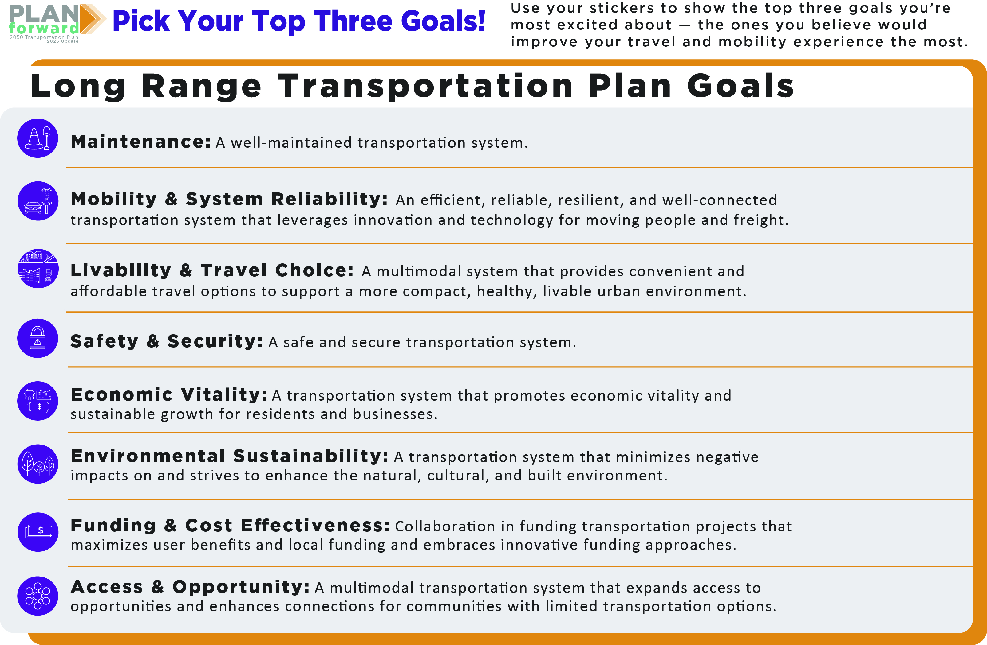

Slide 7
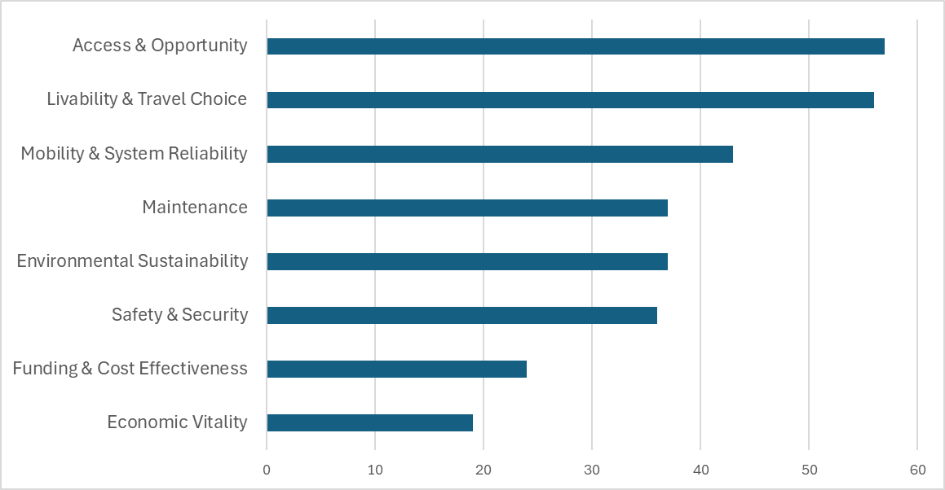
Public Input: Transportation Goals
Which transportation goals are most important to you?

Slide 8
Example Project Score…
Scores will range from 0 - 1
We need your input on the relative weights
Goal Area Score x Weight
Goal/Criterion | Goal Area Score | Weight | Project Score
Maintenance | 0.2 | 20 | 4.0
Mobility and System Reliability | 0.9 | 15 | 13.5
Livability and Travel Choice | 1.0 | 15 | 15.0
Safety and Security | 0.4 | 15 | 6.0
Economic Vitality | 0.5 | 10 | 5.0
Environmental Sustainability | 0.8 | 10 | 8.0
Funding and Cost Effectiveness | 0.7 | 5 | 3.5
Access & Opportunity | 0.6 | 5 | 3.0
Public Support | 0.8 | 5 | 4.0
Total Score |  | 100 | 62
Total Score will range from
0 – 100

Slide 9
Discussion: Weighting of Evaluation Criteria
Goal/Criterion | Lincoln Roadway Projects | Lancaster County Roadway Projects | Trail Projects
Maintenance
Mobility and System Reliability
Livability and Travel Choice
Safety and Security
Economic Vitality
Environmental Sustainability
Funding and Cost Effectiveness
Access & Opportunity
Public Support
Total | 100 | 100 | 100
Should Lincoln roadway projects prioritize different outcomes than County roadway projects?
Should Trail projects elevate certain goals more than roadway projects?
Total Score will range from
0 – 100

Slide 10
Menti Polling
Consider the public input on transportation goals
Consider our discussion about the differences between urban vs. rural projects and roadway vs. trail projects
Your input will be combined with input from the Planning Commission
Total Score will range from
0 – 100

Slide 11
Revenue Forecasts
Start with 2027 revenue estimate
Apply annual growth rate (varies by funding source, average of 2.6%)
24 years of revenues (2027 – 2050)
PRELIMINARY
 | 24 Years of Revenue
Roadway | $5,054.98M
Transit | $836.13M
Trails | $88.68M
Total | $5,979.76M

Slide 12
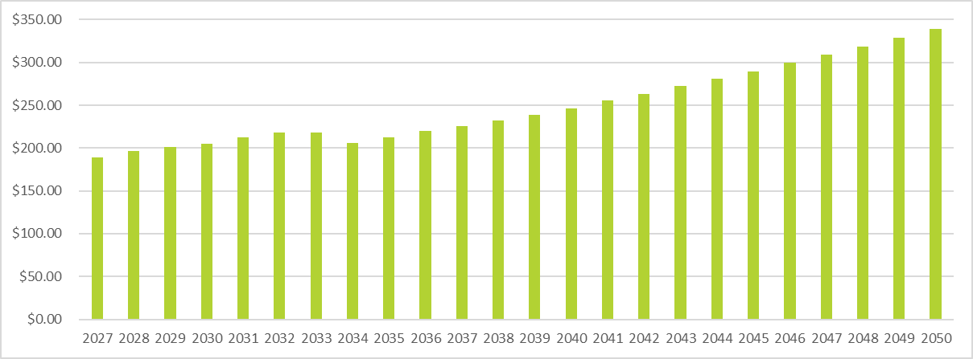

Revenue Forecasts ($M) Over Time
PRELIMINARY
Average Annual Growth Rate = 2.6%
End of Bond Payments
End of LOTM funds
= $5 increase in Wheel Tax

Slide 13
LRTP Project Categories
NDOT
NDOT Projects
Lancaster County
Roadway & Bridge Capital Projects
Pavement Maintenance & Pipes
Lincoln Roadway
Roadway Capital Projects
Rail Crossing Projects
Alternative Modes
Trails
Other Bicycle and Pedestrian Projects
Operations & Maintenance
Other
ITS Technology
East Beltway Preservation
Studies, PE, ROW
Mobility Nodes and Connecting Corridors
Road & Bridge Rehabilitation
System Operations & Maintenance, Minor Intersections
Safety Projects
Trail Rehabilitation
Transit
Safety Projects
Project categories to be scored/prioritized in LRTP
Project categories from Mobility Plan
Projects from Vision Zero Action Plan/Safety Action Plan and Other Safety focused projects

Slide 14
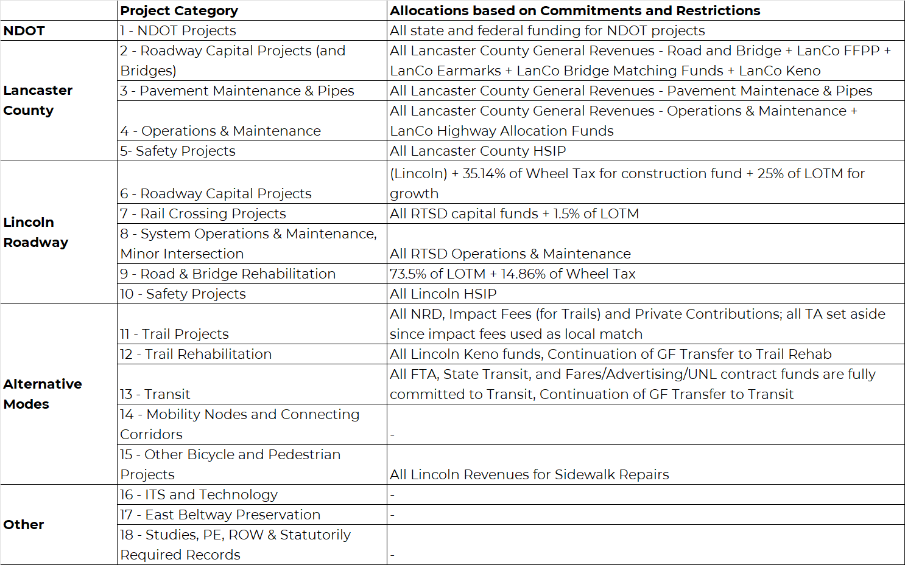
Commitments & Restrictions

Slide 15
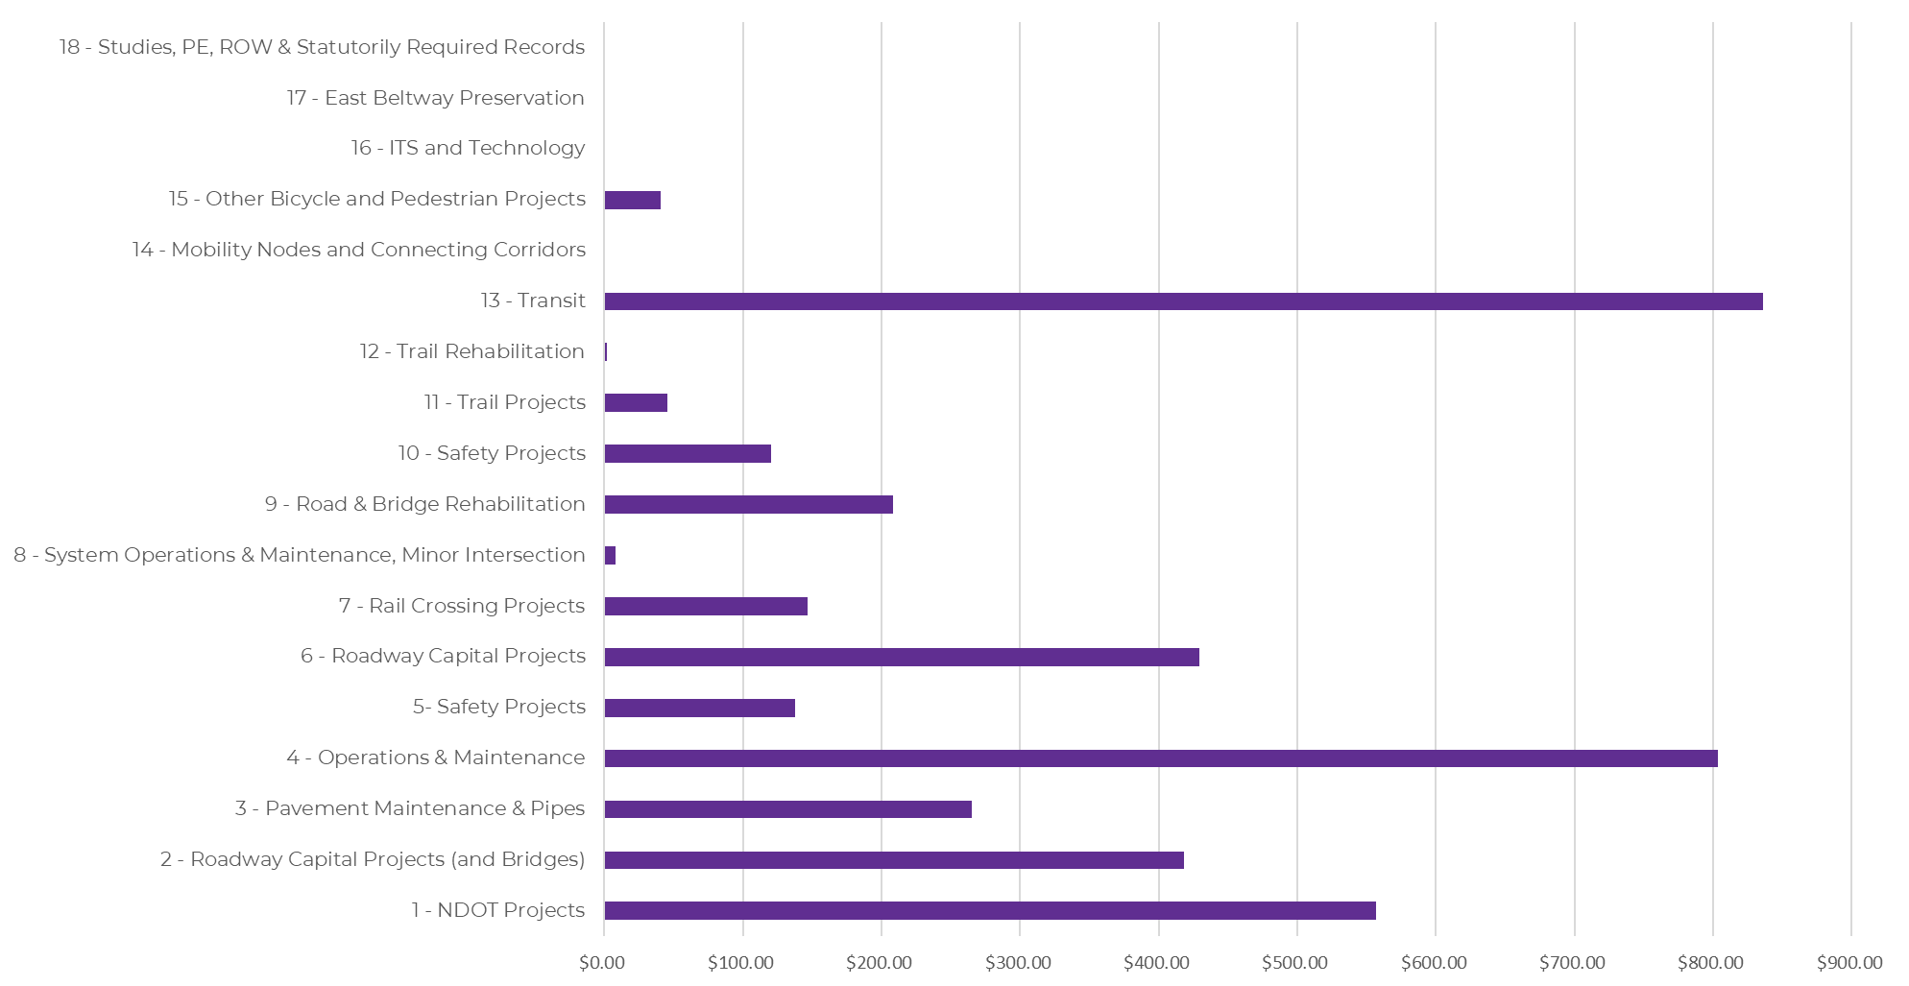
Base Allocation ($M) by Project Category (Restricted and Committed Funding)
PRELIMINARY
Other
Alternative Modes
Lincoln Roadway
Lancaster County
NDOT
NOTE: TIP/CIP Commitments in first four years need to be added as commitments

Slide 16

Committed/Restricted vs. Flexible Funds
PRELIMINARY
Total Revenues (Roadway, Transit, Trails)
Less Committed/Restricted
Remaining Flexible Funds
$5,979.76
$4,019.38
$1,960.38
(about 1/3)

Slide 17
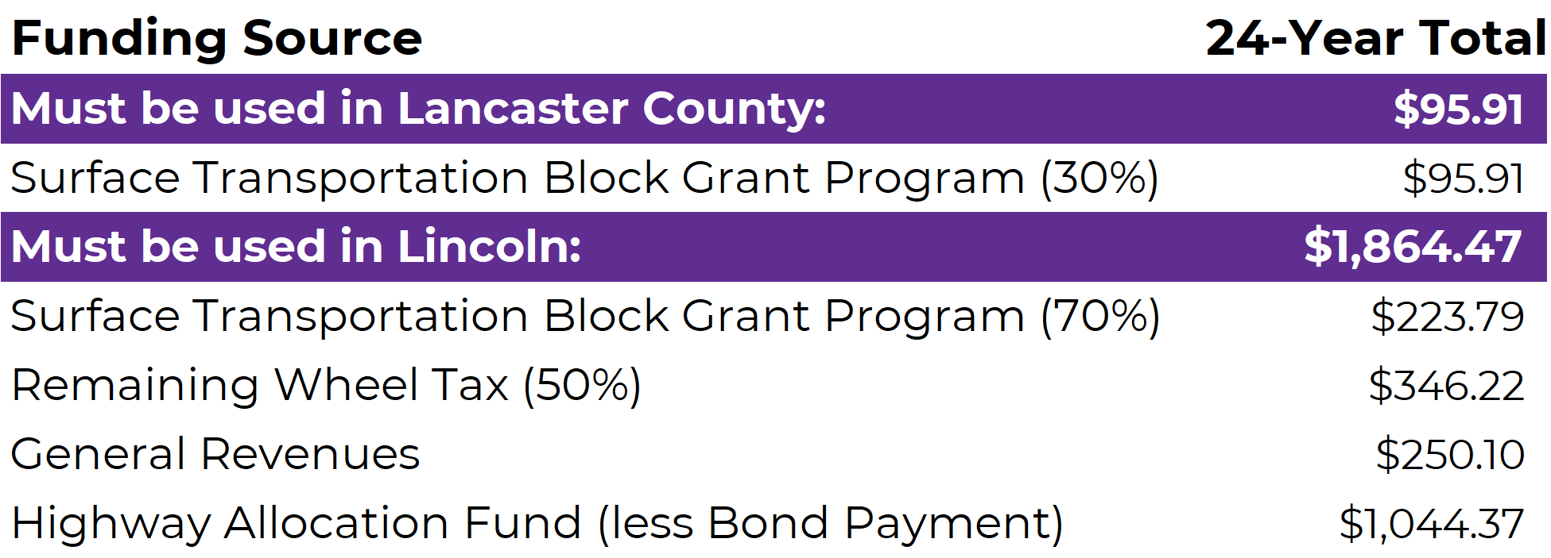
Flexible Funds
PRELIMINARY

Slide 18
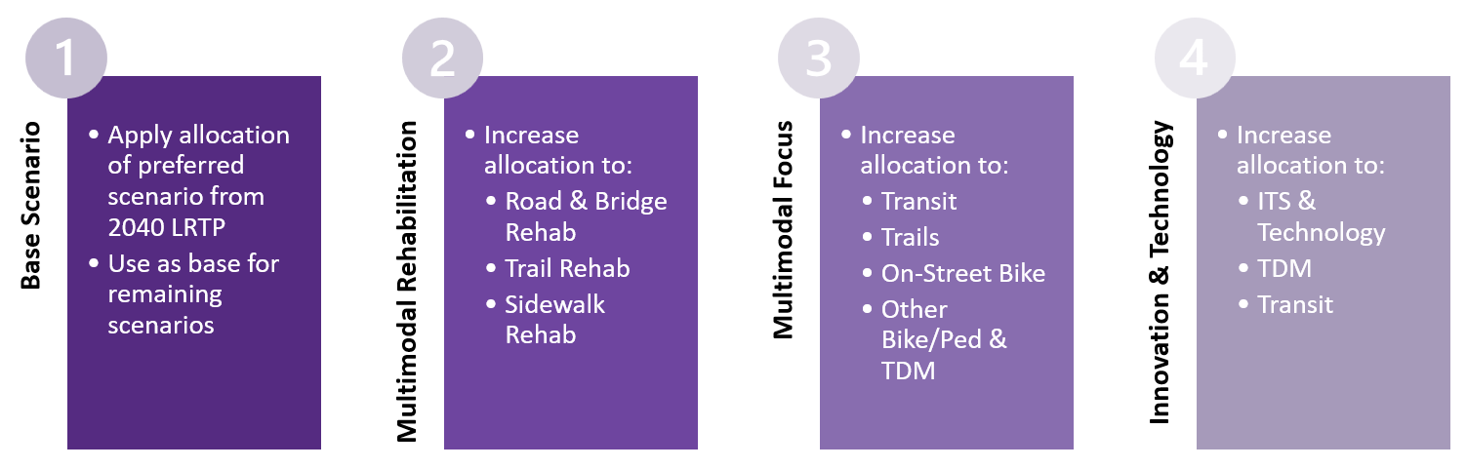
Flexible Funding Scenarios
[from 2021 LRTP]

Slide 19
Discussion:
What funding scenarios are you interested in exploring for the 2050 LRTP Update?

Slide 20
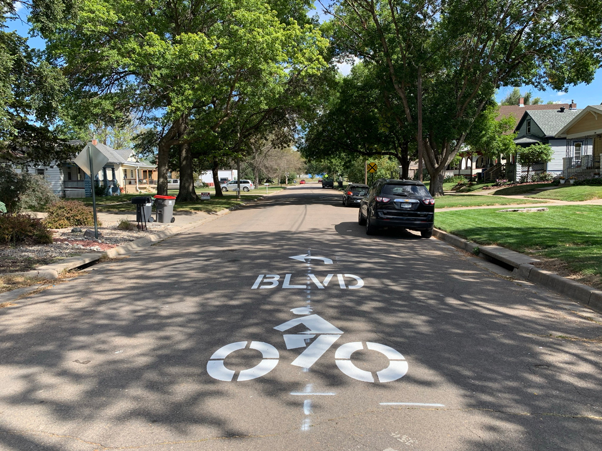

Mobility Plan Update

Slide 21
Project Evaluation and Prioritization
  Project evaluation framework builds from the seven Mobility Plan goals
  Total possible score of one per goal area
  Metrics for evaluation are a combination of existing conditions data and individual project details
  Weighting between goal areas to be determined based on stakeholder input

Slide 22
Evaluation Criteria
Goal Area | Evaluation Criteria
Safety | Proximity to HIN, VRU HIN, and HRN
Connected Network | Barrier Breaker – provides formal crossing of arterial street
 | Gap Closure – completes a gap in the bike network (bonus for Complete Streets gap)
 | Cross-Town Connector – serves a primary cross-town bike connector
Access & Options | Proximity to communities with limited transportation options
Healthy, Active Lifestyle | Proximity to mobility nodes and schools
Sustainable Mobility | Relative volume of short trips
Economic Vitality & Access to Jobs | Proximity to mixed-use or commercial areas Proximity to jobs
Implementation, Funding & Partnerships | Relative cost
 | Ease of implementation
Public Support | Number of public “votes”

Slide 23

Evaluation Criteria: Example

Slide 24
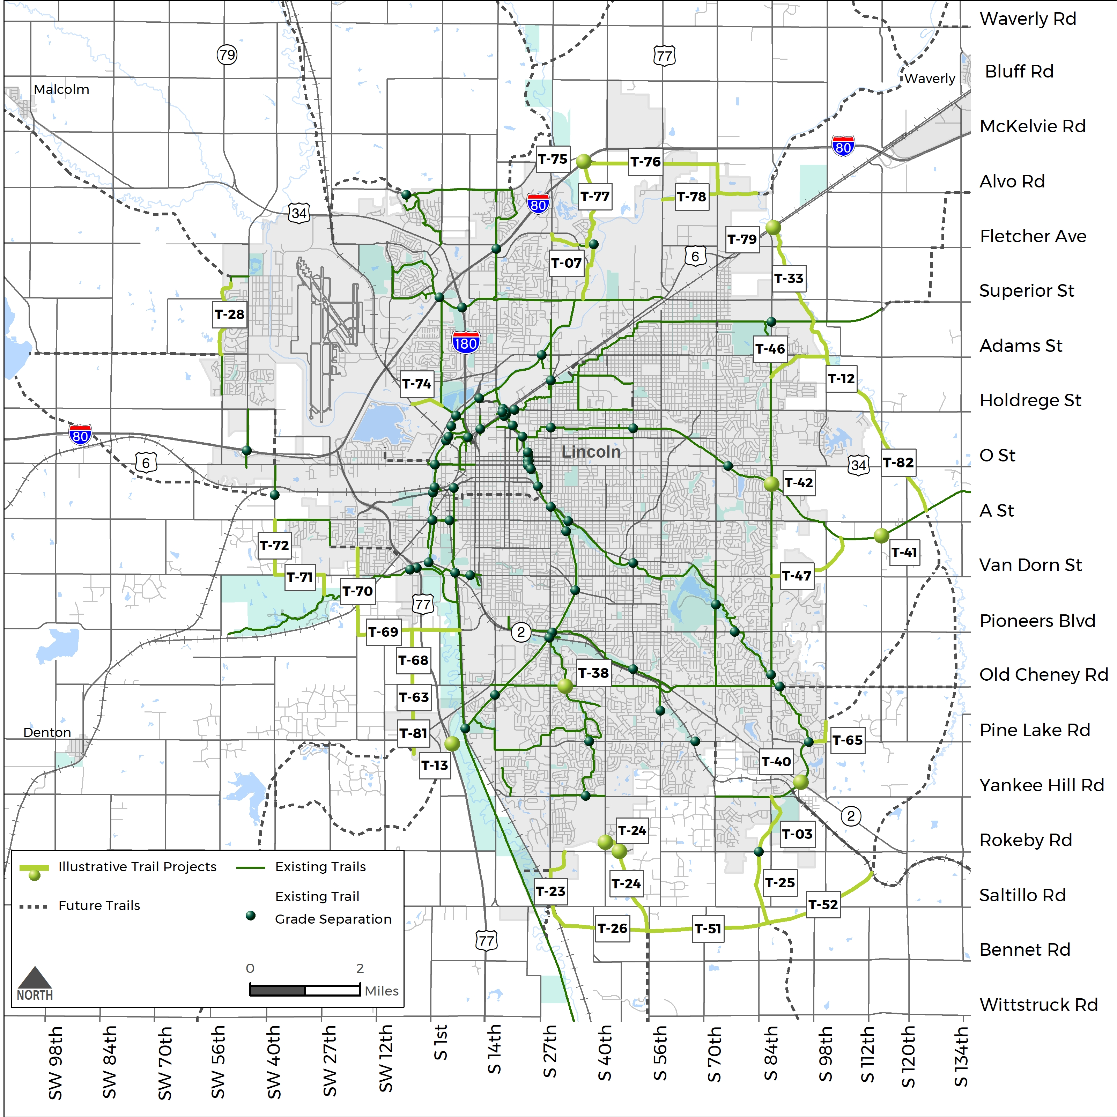
County
Trails (2021)

Slide 25
Mobility Plan Update
Status:
  Reviewed Subcommittee Comments
  Discussion Items:
    Bike Priority Speed Limit – Is there support for LOWERING speed limit to 25 MPH? Prefer this discussion before increasing guideline.
    Does LTU need to be brought in the discussion?
    Collapse "Growth" opportunity nodes to one group. Implementation timing can replace Existing or New naming
    Basis Intermodal Node: Suggest retaining – Many bus stops do not have pads
    Downtown Node Numbers: Reviewing distribution and USES adjacent. Are they different enough to retain nodes?

Slide 26
Mobility Plan Update
Status:
  Discussion Items:
    Distribution of New Growth Nodes – Talk with StarTran regarding transit service extensions in future – Nodes & Transit need to go together
    Coordinate timing and some locations with street projects (will be on-going discussion)
Plan Going Forward:
  Preparing Draft – See Greg's Outline

Slide 27
Mobility Plan Outline
  Introduction
    Previous Plans
    MPO LRTP Coordination
    Relationship of the Mobility Plan to Streets/Roads, Transit, Active Transportation
  Vision & Goals
  Community Input
  Current Conditions
  Typologies & Facility Types
  Mobility Oriented Development Nodes & Corridors
  Active Transportation Network
  Policy & Program Recommendations
  Implementation Plan

Slide 28
Mobility Plan Update
Project scoring underway
Vetting with Mobility Subcommittee (April 1)
Refine project list
Funding analysis (from LRTP & VZAP)
Mobility Oriented Development (MOD) & Policy review

Slide 29
Phase 2 Public Involvement
Public Meeting May 19 (Lincoln Commercial Club)
  Educate newcomers
  Show how input is used
  Set expectations (funding outlook)
  Project types and costs
Virtual public meeting opportunity for input
Re-engaging Focus Group attendees
Coordinated communications (City, County)

Slide 30
Schedule
Mobility Plan Subcommittees – April 1 & April 15
Pop-Up events led by Staff
Public Meeting : May 19 (Lincoln Commercial Club)
Week of June 1:
  Roadway Subcommittee (June 2)
  Mobility Subcommittee (June 3)
  Funding Subcommittee (June 3)
  POP-C (June 5)

